Slide 1
Further demonstrating of Pythagoras’ theorem
Geometrical properties: similarity and Pythagoras’ theorem

Slide 2
how to use Oak lessons

Slide 3
I can appreciate there is a relationship between the lengths of the sides of a right-angled triangle.

Slide 4
Pythagoras’ theorem shows that the sum of the squares of the two shorter sides of a right-angled triangle is equal to the square of its longest side (the hypotenuse).

Slide 5

Further demonstrating Pythagoras’ theorem
Generating right-angled triangles from squares
Introducing Pythagoras’ theorem

Slide 6
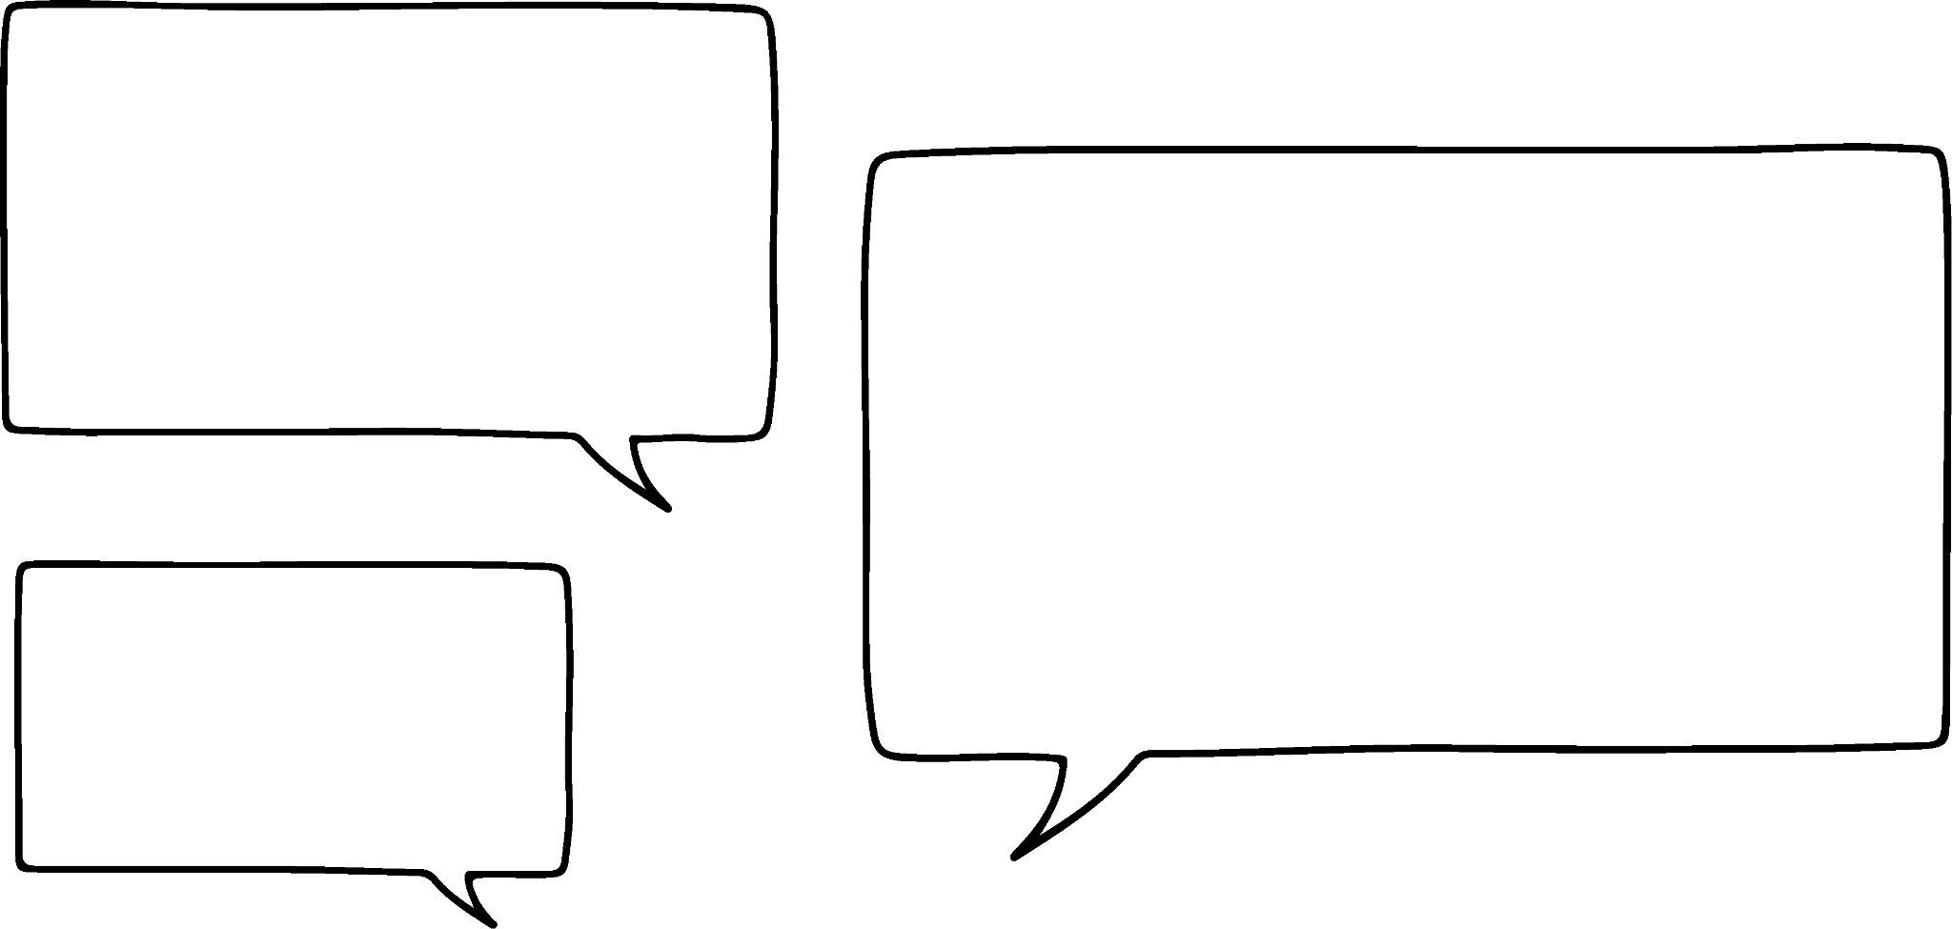
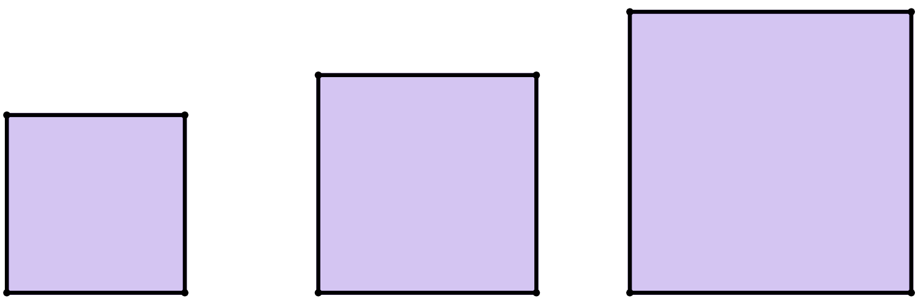

Generating right-angled triangles from squares
So, if I know the areas of any two squares, I instantly know the size of the third square that I need to create a right-angled triangle?
40
units²
16 + 24
units²
16
units²
Laura
The areas of the two smaller squares must add together to make the area of the larger square.
24
units²

Slide 7

Generating right-angled triangles from squares
Then just measure the length of one of its sides, then square that length to find its area that way.
40
units²
16 + 24
units²
16
units²
Laura
But what if you don’t know the area of the squares?
24
units²
Alex

Slide 8
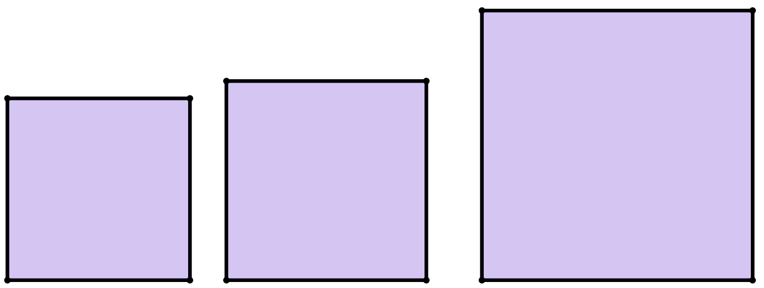
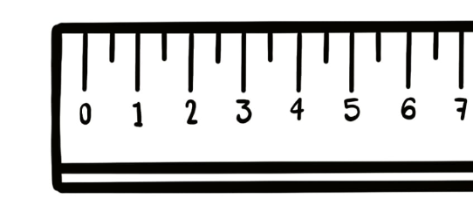
Generating right-angled triangles from squares
Then just measure the length of one of its sides, then square that length to find its area that way.
55
units²
30 + 25
units²
30
units²
Laura
But what if you don’t know the area of the squares?
5²
units²
25
units²
Alex
5 units

Slide 9
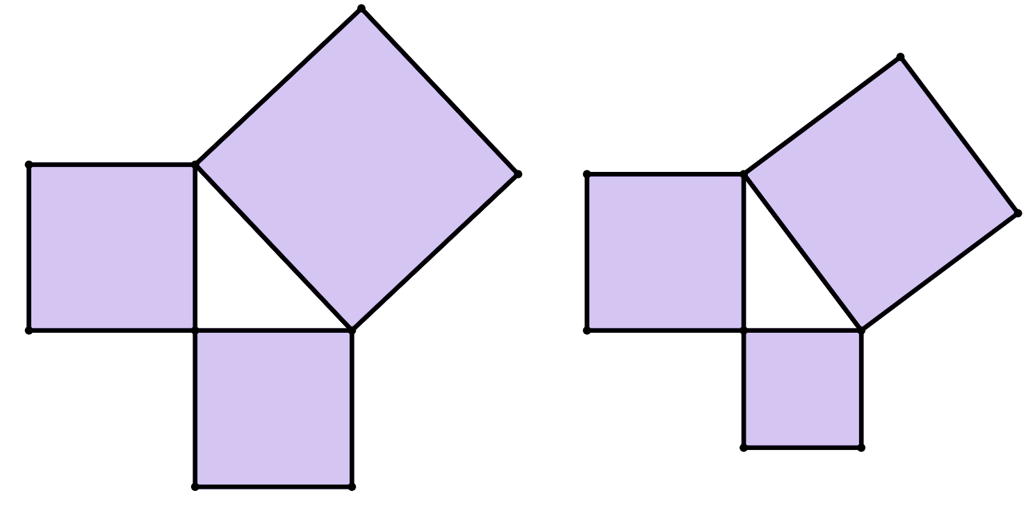
Generating right-angled triangles from squares
What is the area of square B, in units²?
16 units²
34
units²
square C
18
units²
Hence, what is the area of square C, in units²?
square B
16
units²
34 units²
4 units

Slide 10
Generating right-angled triangles from squares
Complete the following sentences:
square C
16 units²
The area of square A is _________
4 units
square A
9 units²
The area of square B is _________
25 units²
16 + 9
The area of square C is _________
square
B
3 units

Slide 11

Generating right-angled triangles from squares
What is the value of x, the side length of square C?
25 units²
25
= 5
4 units
16 units²
The side length of square C is 5 units.
x units
9 units²
3 units

Slide 12
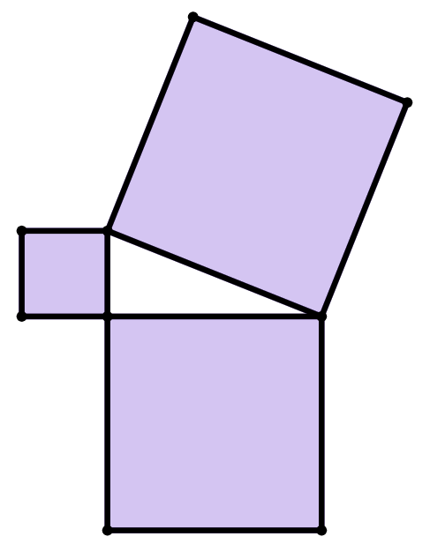
Generating right-angled triangles from squares
Complete the following sentences:
square C
9 units²
square A
The area of square A is _________
7 units
49 - 9
40 units²
The area of square B is _________
3 units
49 units²
The area of square C is _________
square B

Slide 13
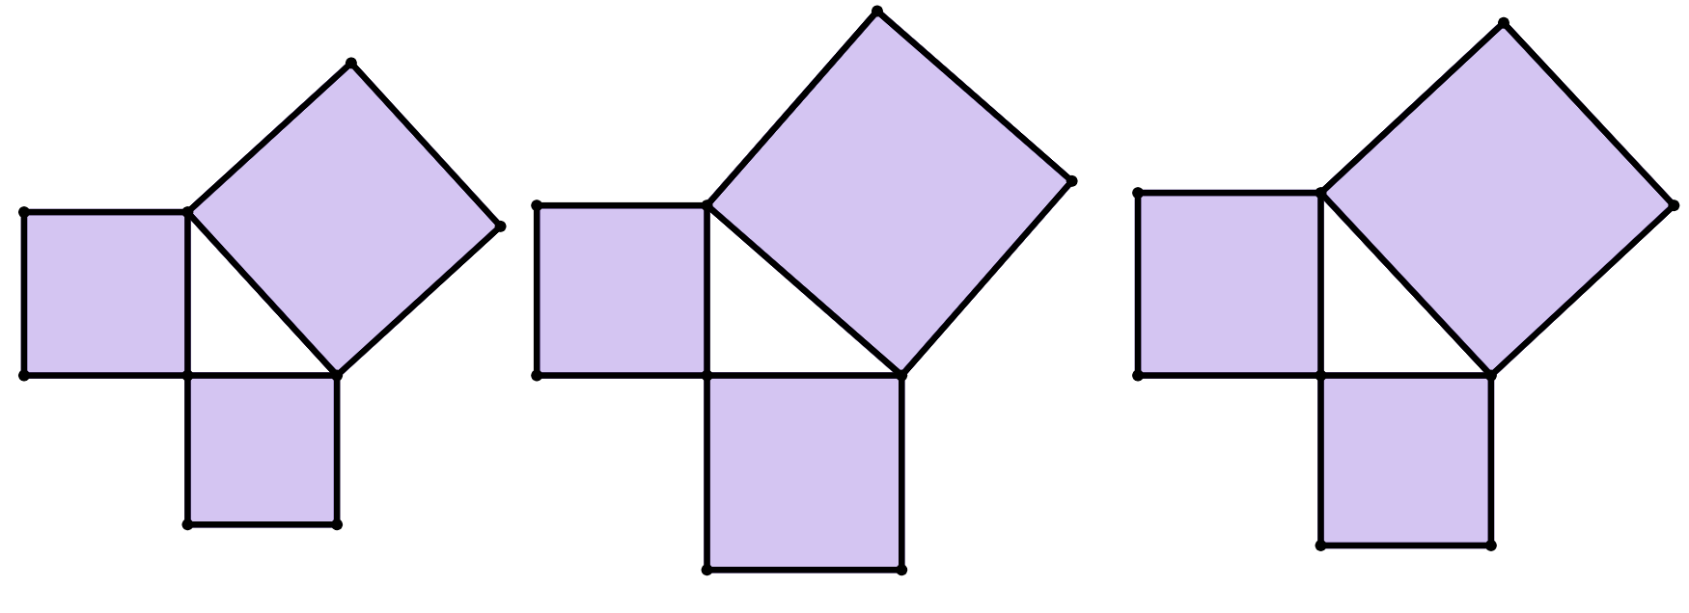
Generating right-angled triangles from squares
1) For each of these right-angled triangles, find the area of each unlabelled square.
b)
17
units²
c)
a)
13
units²
12
units²
13
units²
28
units²
10
units²

Slide 14
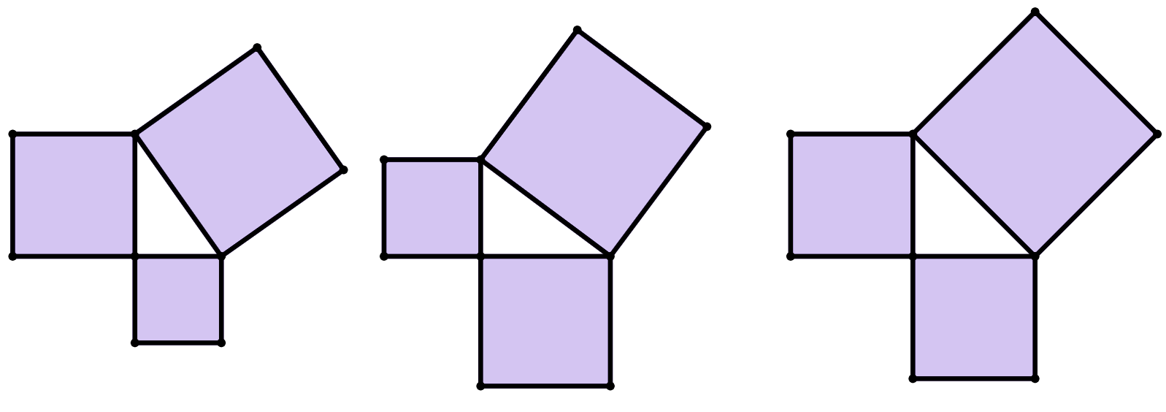
Generating right-angled triangles from squares
2) For each of these right-angled triangles, find the area of all squares.
c)
b)
8
units²
a)
8
units²
5
units²
3 units
2 units
4 units

Slide 15
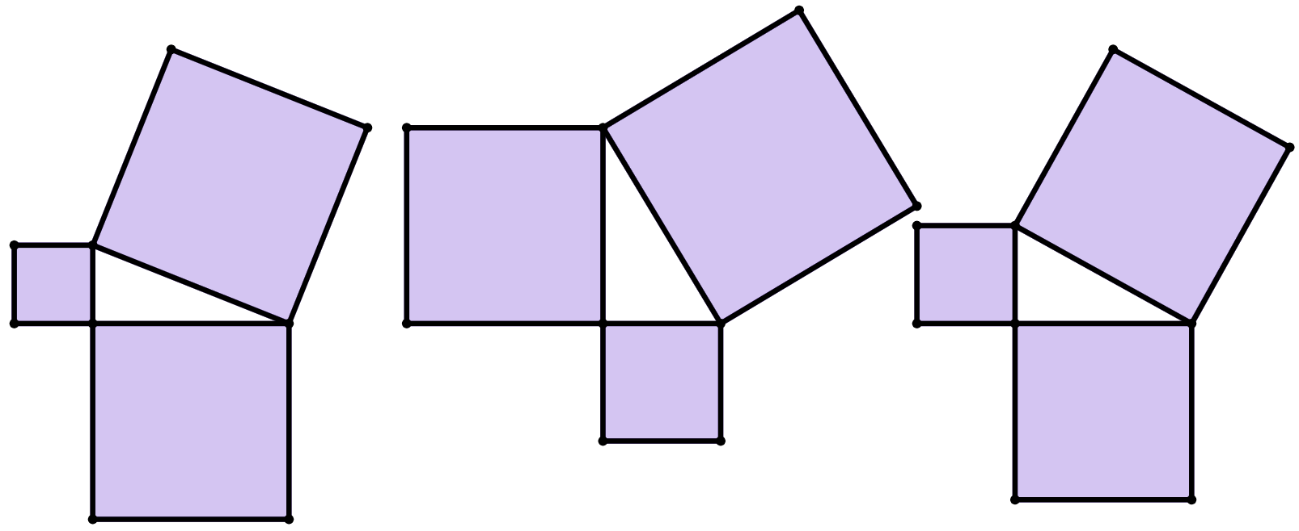
Generating right-angled triangles from squares
3) For each of these right-angled triangles, fill in the area of all squares and find the missing length of each square that is labelled with a letter.
c)
d units
c units
13
units²
a units
169
units²
39
units²
a)
b)
25
units²
e
units
6 units
b units
12 units

Slide 16
Generating right-angled triangles from squares
1) For each of these right-angled triangles, find the area of each unlabelled square.
b)
17
units²
c)
15
units²
a)
22
units²
13
units²
12
units²
13
units²
30
units²
28
units²
10
units²

Slide 17
Generating right-angled triangles from squares
2) For each of these right-angled triangles, find the area of all squares.
c)
b)
8
units²
8
units²
a)
14
units²
12
units²
8
units²
9
units²
16
units²
4
units²
5
units²
3 units
2 units
4 units

Slide 18
Generating right-angled triangles from squares
3) For each of these right-angled triangles, fill in the area of each square and find the missing length of each square that is labelled with a letter.
a = 7
c = 8
d = 13
c)
d units
c units
13
units²
a units
169
units²
49
units²
39
units²
64
units²
25
units²
a)
b)
25
units²
36
units²
e
units
144
units²
e = 5
6 units
b units
b = 5
12 units

Slide 19
Further demonstrating Pythagoras’ theorem
Generating right-angled triangles from squares
Introducing Pythagoras’ theorem

Slide 20
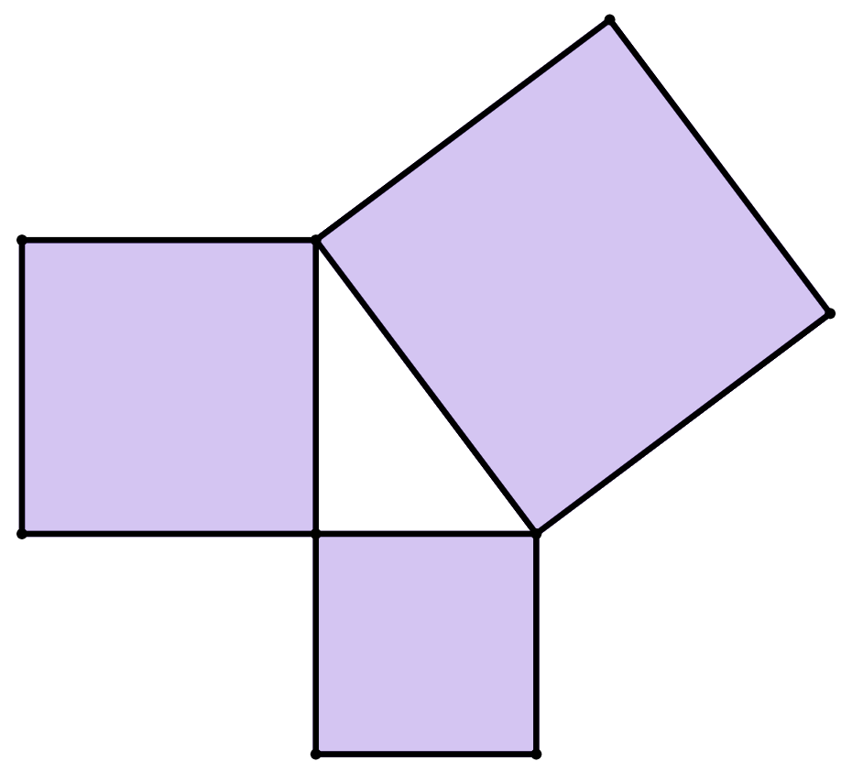

Introducing Pythagoras’ theorem
I think we’ve just done Pythagoras’ theorem.
square C
square A
Sam
area of square A
+
area of square B
=
area of square C
square B

Slide 21
Introducing Pythagoras’ theorem
I think we’ve just done Pythagoras’ theorem.
But it only works if the three squares make a right-angled triangle.
Sam
Alex
Because we’ve seen some triangles with obtuse angles where the area of the largest square is huge compared to the other two squares!
area of square A
+
area of square B
=
area of square C

Slide 22

Introducing Pythagoras’ theorem
I think we’ve just done Pythagoras’ theorem.
What do we do if we don’t know the areas of the squares?
Sam
Lucas
area of square A
+
area of square B
=
area of square C
Oh, Laura said we can just square the length of a side of a square to find its area!
Alex

Slide 23
Introducing Pythagoras’ theorem
area of square A
+
area of square B
=
area of square C
square C
length of side a squared
+
length of side b squared
=
length of side c squared
square A
c units
So, we can write Pythagoras’ theorem like this, too?
square B
a units
Sam
b units

Slide 24
Introducing Pythagoras’ theorem
area of square A
+
area of square B
=
area of square C
square C
a²
b²
c²
c²
length of side a squared
+
length of side b squared
=
length of side c squared
square A
a²
c units
Wait, I’ve heard of Pythagoras’ theorem before, isn’t it also known as this?
square B
a units
b²
Lucas
b units

Slide 25
Introducing Pythagoras’ theorem
area of square A
+
area of square B
=
area of square C
a²
b²
c²
length of side a squared
+
length of side b squared
=
length of side c squared
Wait, I’ve heard of Pythagoras’ theorem before, isn’t it also known as this?
As long as c² is the area of the largest square, I think you’re right!
Lucas
Laura

Slide 26
Introducing Pythagoras’ theorem
So, Pythagoras’ theorem is also this?
Are we sure this works for all right-angled triangles?
We’ve only really demonstrated it works for a few of them…
Sam
a²
+
b²
=
c²
Lucas
I’m sure there’s a proof the teacher can show us that works for all right-angled triangles!
Laura

Slide 27
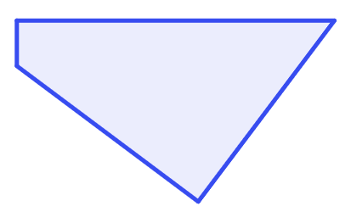
Introducing Pythagoras’ theorem
The area of square A is less than or equal to the area of square B, and square C is the largest square.
Square C is opposite a right-angle.
square C
square A
Because the triangle enclosed by the three squares is a right-angled triangle,
the areas of square A and square B fit perfectly inside square C.
square B

Slide 28


Introducing Pythagoras’ theorem
Select the statement that completes this sentence:
“For Pythagoras’ theorem to be used, three squares must join together to make __________”
a
square C, a square whose area is larger than the other squares
b
an isosceles triangle
c
three congruent squares
d
a right-angled triangle

Slide 29
Introducing Pythagoras’ theorem
Which of these are suitable ways of describing Pythagoras’ theorem for three squares which join at their vertices to create a right-angled triangle?
a
The sum of the areas of the two smaller squares is equal to the area of the larger square.
b
Square the side length of each square, then add together the two smaller numbers. The sum is equal to the largest number.
c
a² + b² = c²
d
c² = b² + a²

Slide 30
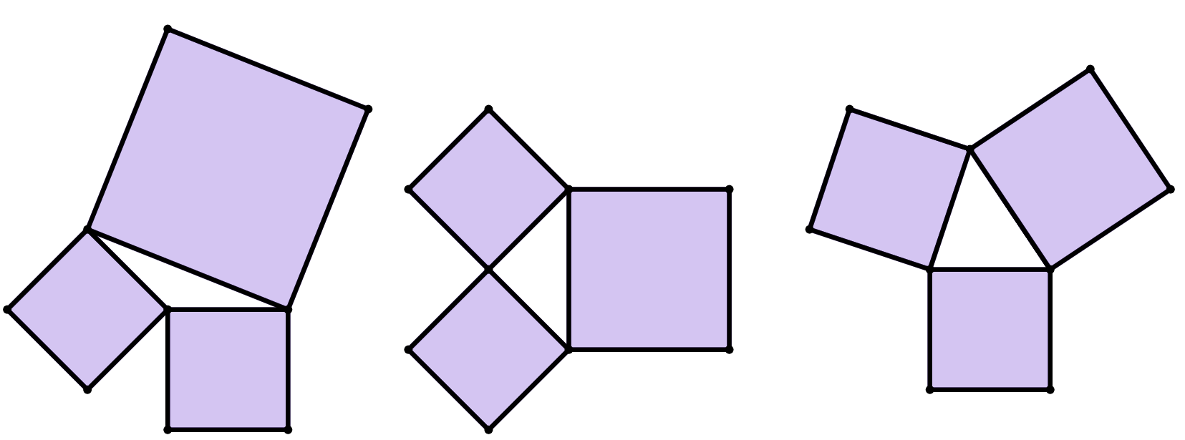
Introducing Pythagoras’ theorem
1) On which of these diagrams is Pythagoras’ theorem true?
c
27
units²
b
21
units²
14
units²
18
units²
a
28
units²
10 units²
16
units²
14
units²
11
units²
2) Explain your reasoning for question 1), and what does it tell you about those triangles?

Slide 31
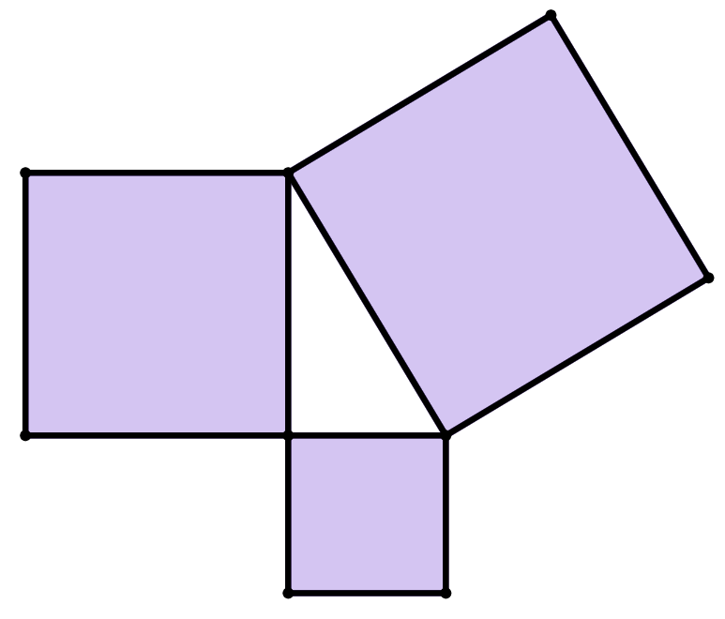
Introducing Pythagoras’ theorem
3) Which of these are valid representations of Pythagoras’ theorem for these three squares which enclose a right-angled triangle?
square H
h units
area of square F plus the area of square G equals the area of square H
square F
a
f units
square G
b
f ² + g² = h²
g units
c
f ² = g² + h²
d
h² = g² + f ²

Slide 32
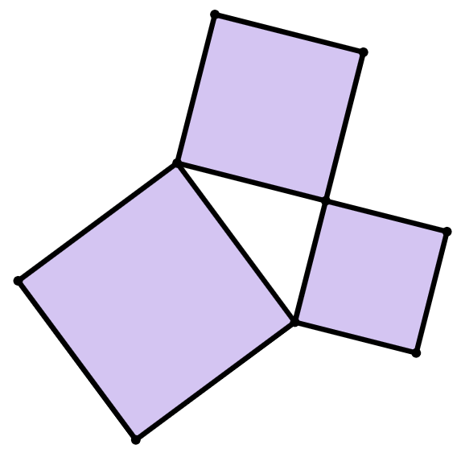
Introducing Pythagoras’ theorem
4) a) What could 15² represent in this diagram?
b) What is the area of the largest square?
c) Fill in the blanks for these calculations of Pythagoras’ theorem.
square B
15 units
square A
square C
8 units
2
+
2
=
2
17 units
+
=
area of square A
area of square B
area of square C

Slide 33
Introducing Pythagoras’ theorem
1) On which of these diagrams is Pythagoras’ theorem true?
c
27
units²
21
units²
14
units²
b
18
units²
a
28
units²
10 units²
16
units²
14
units²
11
units²
2) Explain your reasoning for question 1).
b is the only diagram where the sum of the two smaller areas is equal to the larger area. This is the only right-angled triangle.

Slide 34
Introducing Pythagoras’ theorem
3) Which of these are valid representations of Pythagoras’ theorem for these three squares which enclose a right-angled triangle?
square H
h units
area of square F plus the area of square G equals the area of square H
square F
a
f units
square G
b
f ² + g² = h²
g units
c
f ² = g² + h²
d
h² = g² + f ²

Slide 35
Introducing Pythagoras’ theorem
4) a) What could 15² represent in this diagram?
b) What is the area of the largest square?
c) Fill in the blanks for these calculations of Pythagoras’ theorem.
15² is the area of square B
square B
15 units
Square C has an area of 289 units²
square A
square C
8 units
8
2
+
15
2
=
17
2
17 units
64
+
225
=
289
area of square A
area of square B
area of square C

Slide 36
Further demonstrating of Pythagoras' theorem
Three squares can be joined together at their vertices to create a triangle.
If three congruent squares are joined together, the triangle is equilateral.
If two congruent squares are joined together, the triangle is isosceles.
If all squares have different areas, the triangle is scalene.
The largest angle of the triangle can either be acute, right, or obtuse, depending on whether the sum of the areas of the two smaller squares is greater than, equal to, or less than the area of the largest square, respectively.
When the sum of the areas of the two smaller squares is equal to the area of the largest square, the triangle is always a right-angled triangle. This is a visual demonstration of Pythagoras’ theorem.

Slide 37

© Oak National Academy 2025.
Produced in partnership with Mathematics in Education and Industry.
Licensed on the Open Government Licence v3.0, except where otherwise stated. See Oak terms and conditions.

